Slide 1
Sentiment Analysis of Incoming Calls on Helpdesk
PIP4004 University Project-II
Review-4
Batch Number: COM23
Student Name | Roll Number
20211COM0006 | DISHIK L SETTY
20211COM0075 | DEEPIKA C S
20211CEI0055 | PRAKASH SINGH
20211COM0029 | PAAVANA GOWDA
Under the Supervision of,
Ms. IMPA B H
Assistant Professor
School of Computer Science and Engineering
Presidency University
Name of the Program: Computer Engineering
Name of the HoD: Dr.Gopal Krishna Shyam
Name of the Program Project Coordinator: Dr.Sudha P
Name of the School Project Coordinators: Mr. Md Ziaur Rahman

Slide 2
Introduction of our Project
In the age of AI-driven communication, this Flask-based backend offers a powerful audio processing solution tailored for modern industry needs. Supporting formats like WAV, MP3, FLAC, and M4A, it performs advanced tasks such as audio denoising using DeepFilterNet, multilingual transcription with Faster-Whisper, and intelligent text interpretation through sentiment and sarcasm analysis.
Designed for efficiency and scalability, it leverages MongoDB with GridFS for data storage and supports CORS for seamless integration. With robust logging and error handling, this platform goes beyond transcription to deliver deep insights into audio content, making it ideal for media, customer service, and content moderation applications.

Slide 3
Literature Review
“Sentiment Analysis in Customer Service Calls Using Deep Learning, NLP, and Cloud-ready database management.”
Author : Karakus & Aydin (2017), Ezzat et al. (2018), Fu et al. (2020), Sehgal et al. (2021), Jia & SungChu (2022)
Description : These studies present diverse AI-driven approaches to sentiment analysis in call centers, ranging from Big Data text evaluations and audio transcription to multimodal deep learning. Techniques include Hadoop-based processing, transformer models, ASR integration, and semi-supervised learning. Key limitations include ASR inaccuracies, binary sentiment constraints, and difficulties in tracking dynamic, real-world emotional expressions.

Slide 4
Literature Review
“Multilingual Sentiment Analysis Using Deep Learning”
Author : Sharma et al. (2021)
Description:This research focuses on sentiment classification across multiple Indian languages using deep learning models like BERT and LSTM. The study demonstrates that transformer-based models outperform traditional machine learning models in multilingual sentiment detection. The authors also highlight the challenges of code-mixing and suggest fine-tuning language-specific embeddings to improve accuracy.

Slide 5
Literature Review
“Speech-to-Text Accuracy in Multilingual Environments”
Author :Kumar et al. (2020)
Description: This study evaluates the efficiency of different speech recognition models, including Google Speech-to-Text API, DeepSpeech, and Wav2Vec2, in transcribing Indian languages. The authors conclude that deep learning-based ASR models provide better transcription accuracy for accented and mixed-language speech, which is essential for sentiment analysis in call centers.

Slide 6
Research Gaps Identified
Lack of Robustness to Noisy and Incomplete Data — Xue-Yong Fu, Cheng Chen, Md Tahmid Rahman Laskar, Shayna Gardiner, Pooja Hiranandani, and Shashi Bhushan TN
Challenges in Emotion Detection from Text — Souraya Ezzat, Neamat El Gayar, Moustafa M. Ghanem
Limited Coverage and Random Sampling — Betül Karakus and Galip Aydin
Dependence on Limited Emotion Categories — Rohit Raj Sehgal, Shubham Agarwal, and Gaurav Raj
Lack of Fine-Grained Temporal Sentiment Tracking — Yanan Jia and Sony SungChu

Slide 7
Proposed Methodology
The proposed system presents a robust backend for intelligent audio analysis through a modular Flask-based RESTful API. It supports multiple audio formats and begins by denoising inputs using DeepFilterNet to enhance clarity. Transcription is performed via Faster-Whisper, enabling multilingual recognition. The transcribed text is then analyzed for sentiment and sarcasm using pre-trained and fine-tuned NLP models.
Results, along with original and processed data, are stored in MongoDB using GridFS for scalable file management. The system returns a structured JSON response and includes comprehensive logging and error handling. This architecture ensures accurate, scalable, and insightful audio content processing across diverse applications.

Slide 8
Objectives
Develop an Automated Sentiment Analysis System – Implement speech-to-text conversion and NLP-based sentiment classification to analyze customer emotions in multilingual helpdesk calls.
Enhance Real-Time Customer Interaction Monitoring – Provide live sentiment detection with an alert system for identifying negative interactions, allowing businesses to take proactive customer support actions.
Improve Decision-Making through Sentiment Analytics – Integrate a dashboard visualization system to track sentiment trends, agent performance, and customer satisfaction, enabling data-driven improvements in customer service operations.

Slide 9
Methodology/Modules
Speech-to-Text Conversion – Converts multilingual customer calls into text using ASR models (Wav2Vec2, DeepSpeech).
Text Preprocessing & Feature Extraction – Cleans text, detects language, and extracts sentiment-related features (TF-IDF, BERT embeddings).
Sentiment Classification – Uses ML (SVM, Random Forest) and DL (LSTM, BERT) to classify sentiment as Positive, Neutral, or Negative.
Real-Time Sentiment Analysis & Dashboard – Provides live sentiment tracking, alerts for negative interactions, and dashboard visualization.

Slide 10
System design and Implementation
Speech-to-Text Conversion Module – Uses ASR models (Wav2Vec2, DeepSpeech) to transcribe customer calls while handling noise reduction and speaker diarization.
Text Preprocessing & Language Identification – Cleans and processes text by removing stopwords, tokenizing, and detecting language, ensuring better sentiment classification.
Sentiment Classification Model – Implements ML (SVM, Random Forest) and DL (LSTM, BERT) models to classify sentiments as Positive, Neutral, or Negative.
Dashboard & Alert System – Displays sentiment trends, agent performance, and customer satisfaction insights while triggering real-time alerts for negative interactions.

Slide 11
Architecture
Speech Processing Layer – Converts customer speech into text using Automatic Speech Recognition (ASR) models like Wav2Vec2, DeepSpeech, with noise reduction and speaker identification.
Text Processing & Feature Extraction Layer – Performs language detection, text normalization, tokenization, and feature extraction (TF-IDF, Word2Vec, BERT embeddings).
Sentiment Analysis Layer – Uses Machine Learning (SVM, Random Forest) and Deep Learning (LSTM, BERT) models to classify sentiment as Positive, Neutral, or Negative.

Slide 12
Hardware/software components
Processor – Intel i5/i7 or AMD Ryzen (for efficient ML/DL model execution).
RAM – Minimum 8GB (16GB recommended) for handling large datasets.
GPU (Optional) – NVIDIA GPU (e.g., RTX 3060) for faster deep learning model training.
Storage – Minimum 256GB SSD (512GB+ recommended) for storing datasets and model weights.
Microphone & Audio Interface – For capturing real-world customer calls (if required for dataset collection).

Slide 13
Hardware/software components
Programming Language – Python 3.8+ (for ML/DL implementation).
Libraries & Frameworks:
Speech Recognition – Wav2Vec2, DeepSpeech.
NLP & Sentiment Analysis – NLTK, BERT, TensorFlow, Scikit-learn.
Data Processing – Pandas, NumPy, TF-IDF.
Dashboard & Visualization – Flask, Power BI/Tableau.
Database – MySQL / MongoDB (for storing processed data).
Operating System – Windows/Linux/MacOS.

Slide 14
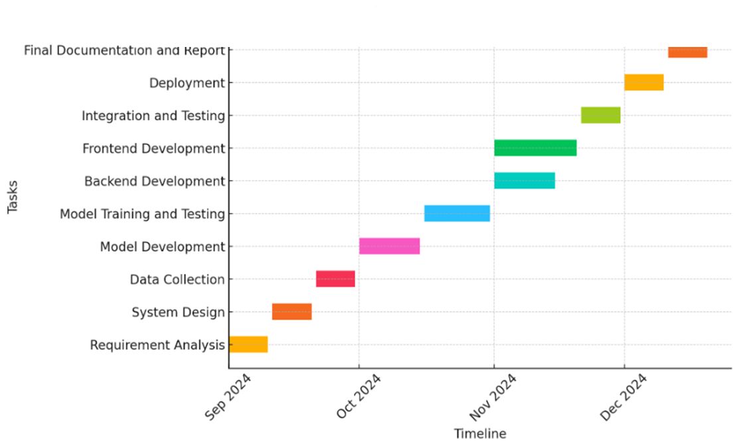
Timeline of Project

Slide 15
Expected Outcomes
Automated Sentiment Detection – Accurately classifies customer emotions as Positive, Neutral, or Negative using ML and DL models.
Real-Time Sentiment Monitoring – Provides instant feedback on customer interactions with alerts for negative sentiment.
Improved Customer Service Insights – Helps businesses track sentiment trends, agent performance, and customer satisfaction using a dashboard.
Enhanced Decision-Making – Enables data-driven strategies to improve service quality, reduce complaints, and increase customer retention.

Slide 16
Conclusion
The Sentiment Analysis of Incoming Calls on Helpdesk project successfully integrates speech-to-text conversion, natural language processing (NLP), and machine learning (ML)/deep learning (DL) models to analyze customer sentiments in real-time. By leveraging ASR models (Wav2Vec2, DeepSpeech) and sentiment classification models (SVM, LSTM, BERT), the system accurately detects customer emotions across multiple Indian languages. The implementation of a real-time monitoring dashboard and alert system enhances customer support efficiency by enabling businesses to take proactive measures in handling negative interactions.
This project significantly improves customer engagement, service quality, and decision-making through sentiment-driven insights.

Slide 17
References
B. Liu, Sentiment Analysis and Opinion Mining, Morgan & Claypool Publishers, 2012.
R. Feldman, "Techniques and Applications for Sentiment Analysis," Communications of the ACM, vol. 56, no. 4, pp. 82-89, 2013.
Kumar et al., "Speech-to-Text Accuracy in Multilingual Environments," International Journal of Speech Technology, vol. 25, pp. 99-110, 2022.
Sharma et al., "Multilingual Sentiment Analysis Using Deep Learning," IEEE Transactions on Affective Computing, vol. 10, no. 2, pp. 125-138, 2021.

Slide 18
Publication Details

Slide 19

Thank You

